Slide 1
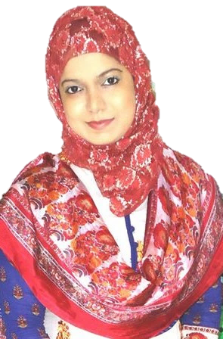


Introduction to Business (BUS 101). Lecture Delivered by: Nusrat Hafiz (NHF)

Slide 2
Discussion Agenda
Introduction to Business (BUS 101). Course Instructor: Nusrat Hafiz (NHF)
Social Environment
Global Environment
Ecological Environment

Slide 3


4. SOCIAL ENVIRONMENT
*
Introduction to Business (BUS 101). Course Instructor: Nusrat Hafiz (NHF)
The Social Environment
and Managing Diversity
LG6
*
Demography is the statistical study of human population with
regard to size, density and other characteristics, i.e., age, race, gender & income.
- Diversity has grown from just recruiting minority and female workers.
- Two income families
Changes in customers’ tastes and preferences
1-3

Slide 4


5. GLOBAL ENVIRONMENT
Introduction to Business (BUS 101). Course Instructor: Nusrat Hafiz (NHF)
*
The Global Environment
*
LG7
Significant changes in global environment are
Contributed by:
Increase of global competition
Increase of free trade among nations
1-4

Slide 5

5. GLOBAL ENVIRONMENT
Introduction to Business (BUS 101). Course Instructor: Nusrat Hafiz (NHF)
*
The Global Environment
*
LG7
Video Explanation on Globalization https://youtu.be/JJ0nFD19eT8
1-5

Slide 6



5. GLOBAL ENVIRONMENT
Introduction to Business (BUS 101). Course Instructor: Nusrat Hafiz (NHF)
*
The Global Environment
*
LG7
Negative effects of globalization on businesses:
Wars and terrorism
Global Pandemic
How to stay updated with globalization?
1-6

Slide 7

6. Ecological Environment
Introduction to Business (BUS 101). Course Instructor: Nusrat Hafiz (NHF)
*
The Ecological Environment
*
LG7
Video: Climate Change in 60 seconds https://youtu.be/n4e5UPu1co0
1-7

Slide 8


6. Ecological Environment
Introduction to Business (BUS 101). Course Instructor: Nusrat Hafiz (NHF)
*
The Ecological Environment
*
LG7
More than just climate change
Greening: The trend toward saving energy and producing products that cause less harm to environment.
1-8

Slide 9
Suggested Readings
Introduction to Business (BUS 101). Course Instructor: Nusrat Hafiz (NHF)
https://www.bondora.com/blog/entrepreneurship-versus-employment/
https://www.weforum.org/agenda/2020/04/covid-19-coronavirus-bangladesh/
https://www.forbes.com/sites/dorieclark/2013/07/09/how-to-stay-relevant-in-a-changing-business-environment/#55c04ee5bc1e
Chapter Summary

Slide 10
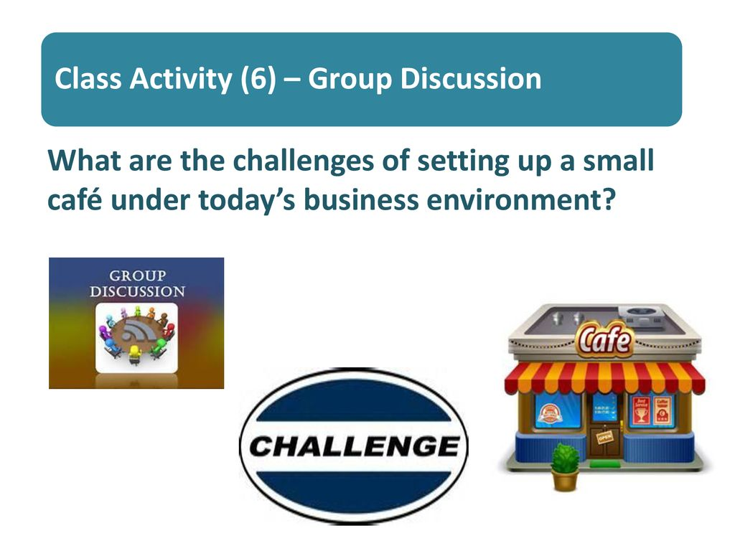
Team Assignment
Video presentation: Discuss the external business environmental issues faced by a small café in your city.

